Slide 1
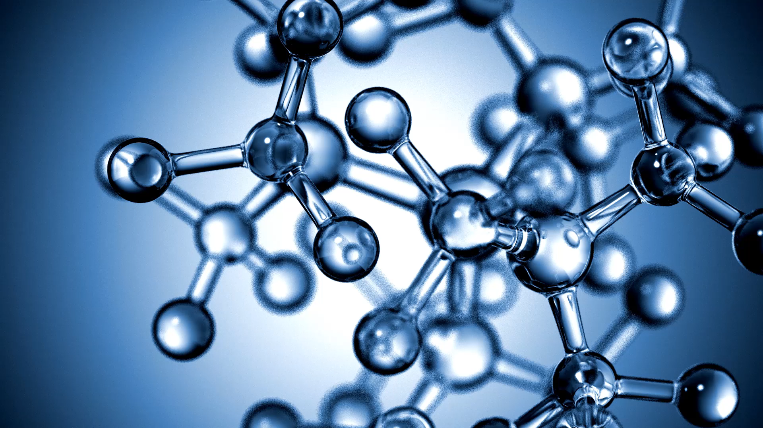
DNA
ATHBY Human Biology

Slide 2
Preview
18(9) | M3 | 10 | Unit 2 – Reproduction and inheritance DNA occurs bound to proteins in chromosomes in the nucleus and as unbound DNA in the mitochondria | Ch 9
 | T5 | 11 | DNA stores the information for the production of proteins that determines the structure and function of cells
 | T5 | 11 | DNA stores the information for the production of proteins that determines the structure and function of cells
 | W4 | 12 | the structural properties of the helical DNA molecule, including double-stranded, nucleotide composition and weak bonds involved in base pairing between the complementary strands, allow for its replication
 | W4 | 12 | the structural properties of the helical DNA molecule, including double-stranded, nucleotide composition and weak bonds involved in base pairing between the complementary strands, allow for its replication
 | F1 | 14
19(10) | M3 | 17 | discoveries made through the use of modern biotechnological techniques have increased understanding of DNA and gene expression
19(10) | M3 | 17 | discoveries made through the use of modern biotechnological techniques have increased understanding of DNA and gene expression
 | T5 | 18 | protein synthesis involves the transcription of a gene on DNA into messenger RNA in the nucleus, and translation into an amino acid sequence at the ribosome with the aid of transfer RNA
 | T5 | 18 | protein synthesis involves the transcription of a gene on DNA into messenger RNA in the nucleus, and translation into an amino acid sequence at the ribosome with the aid of transfer RNA
 | W4 | 19 | select, construct and use appropriate representations, including models of DNA replication, transcription and translation, to communicate conceptual understanding, solve problems and make predictions
 | W4 | 19 | select, construct and use appropriate representations, including models of DNA replication, transcription and translation, to communicate conceptual understanding, solve problems and make predictions |  | Task 7: Practical DNA and protein synthesis (5%)
 | F1 | 21 | epigenetics is the study of phenotypic expression of genes, which depends on the factors controlling transcription and translation during protein synthesis, the products of other genes, and the environment
 | F1 | 21 | epigenetics is the study of phenotypic expression of genes, which depends on the factors controlling transcription and translation during protein synthesis, the products of other genes, and the environment

Slide 3
Review
List the elements found in each of the four classes of biomolecules.
Animal Cell - Map Quiz Game - Seterra (geoguessr.com)
Compare and contrast simple diffusion and facilitated diffusion (6 marks)

Slide 4
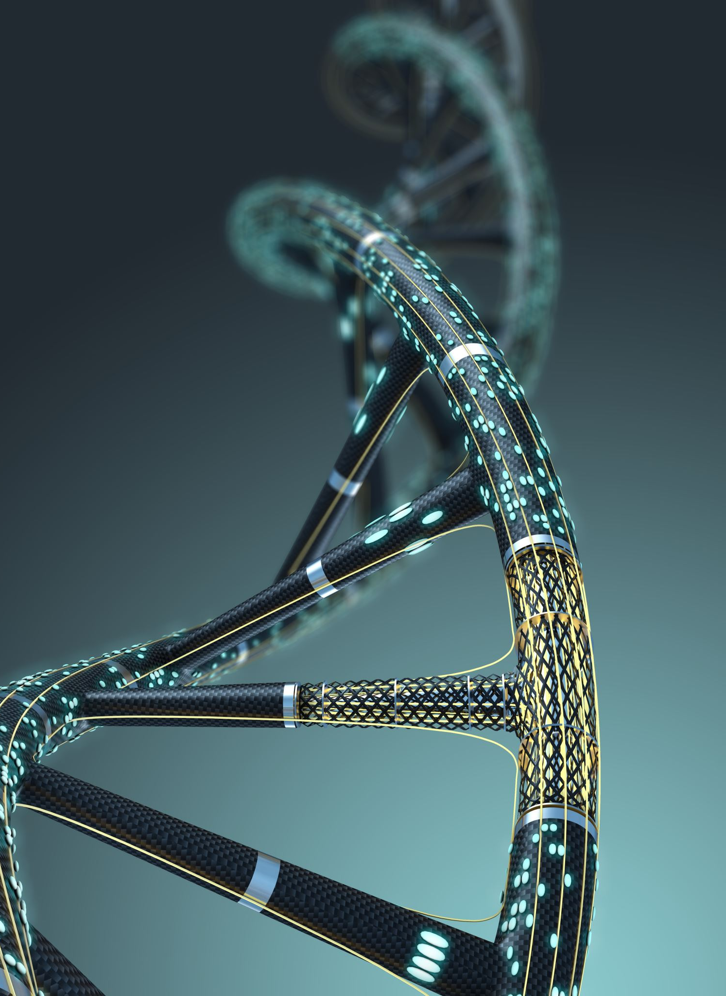
Learning Intentions
DNA occurs bound to proteins in chromosomes in the nucleus and as unbound DNA in the mitochondria.

Slide 5
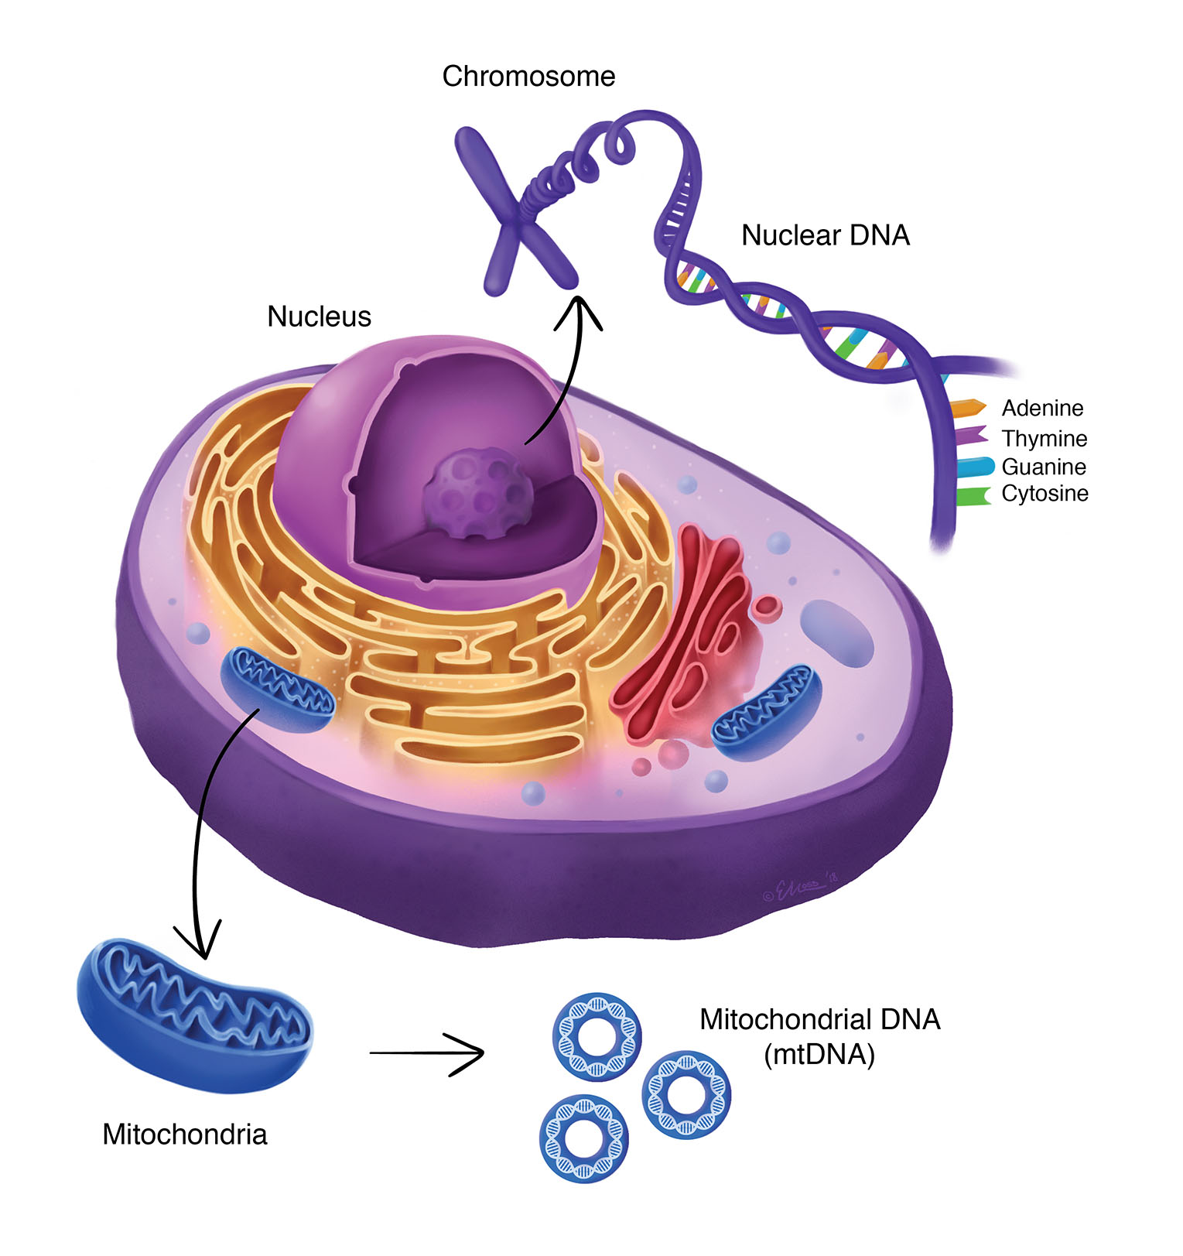
Success criteria
Label a diagram of a nucleotide.
Describe the 5’ and 3’ strands of DNA
List the four nitrogenous bases found in DNA
Compare and contrast nuclear and mitochondrial DNA

Slide 6
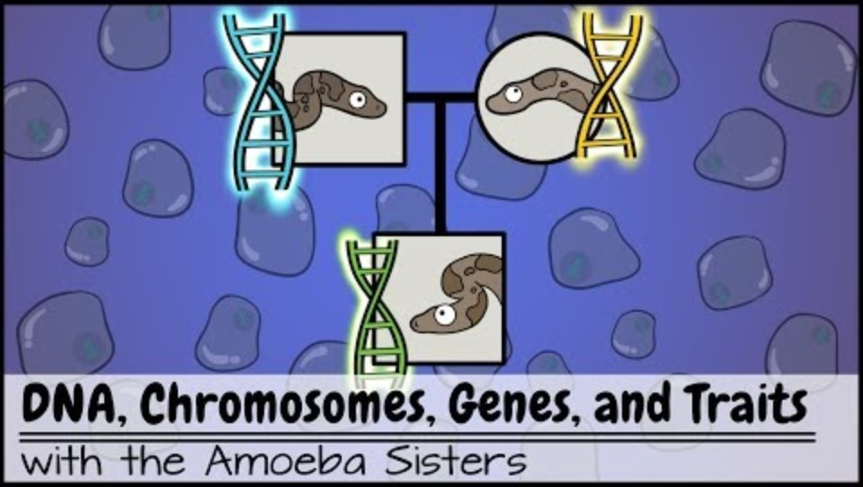

Slide 7
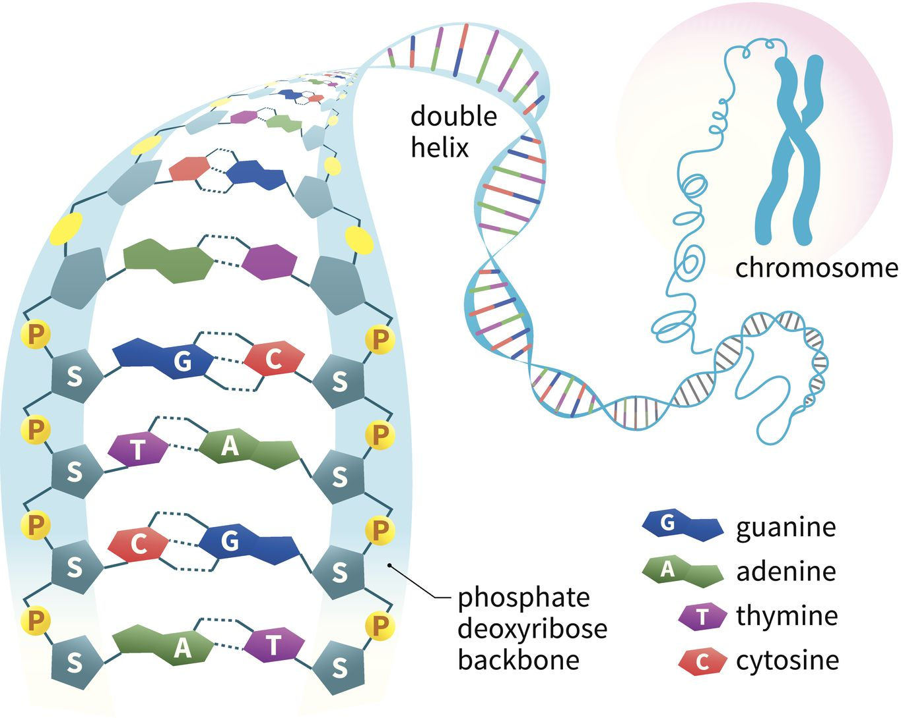

Slide 8
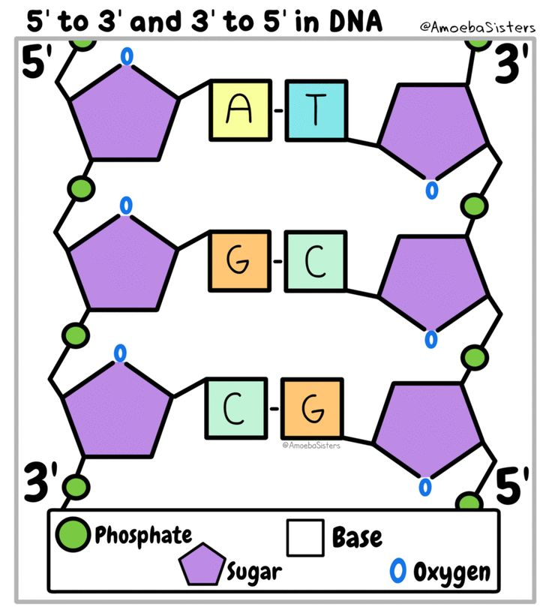

Slide 9
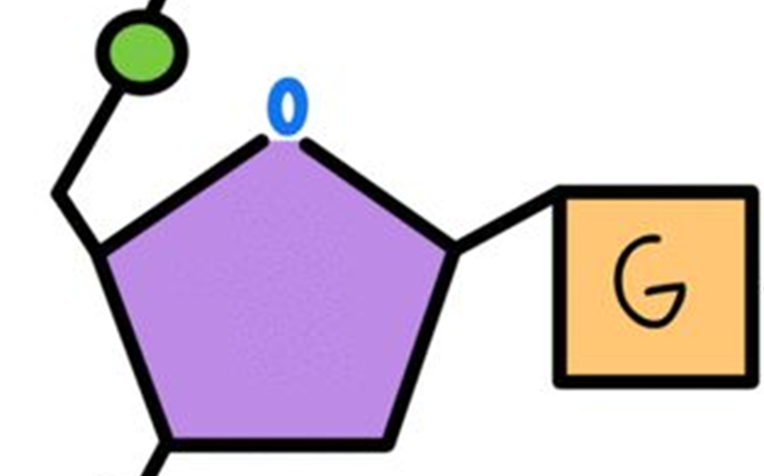
DNA structure: 3’and 5’ asymmetry
Oxygen
The 5' "five prime" and 3' "three prime" refer to the carbon numbers in the DNA's sugar backbone.
The 5' carbon has a phosphate group attached to it and the 3' carbon a hydroxyl (-OH) group. This asymmetry gives a DNA strand a "direction".
When reading or copying DNA, the enzymes always move from 5’to 3’.
5
1
4
3
2

Slide 10
5’
3’

Slide 11
Mitochondrial and nuclear DNA
Both nuclear DNA and mitochondrial DNA contribute to the genetic makeup of the cell.
The main difference is that mitochondrial DNA is encoded for the genetic information required by mitochondria whereas nuclear DNA is encoded for the genetic information required by the entire cell.

Slide 12
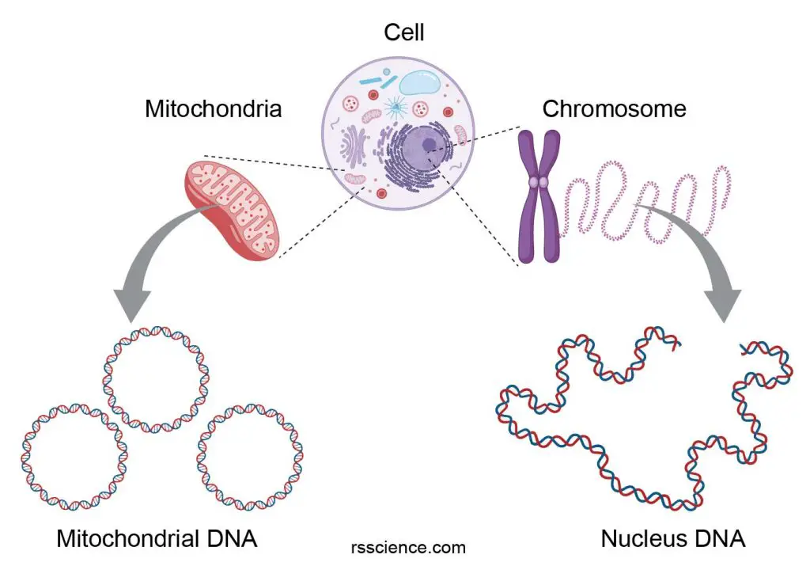

Slide 13
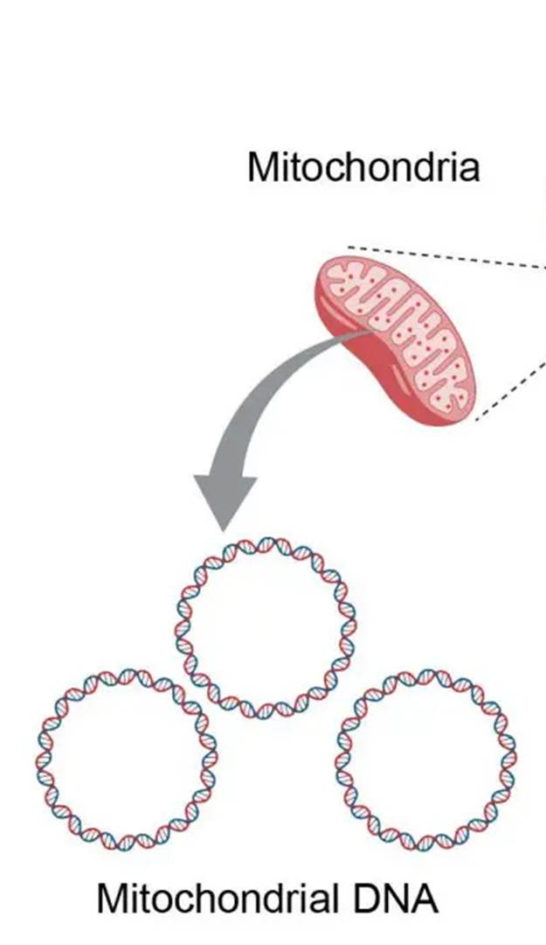
Mitochondrial DNA
Mitochondrial DNA (mtDNA) is an unbound, double-stranded, circular DNA found inside the mitochondria.
It codes for proteins and functional RNAs required by mitochondria.
Mitochondrial DNA is short compared to the nuclear DNA.

Slide 14
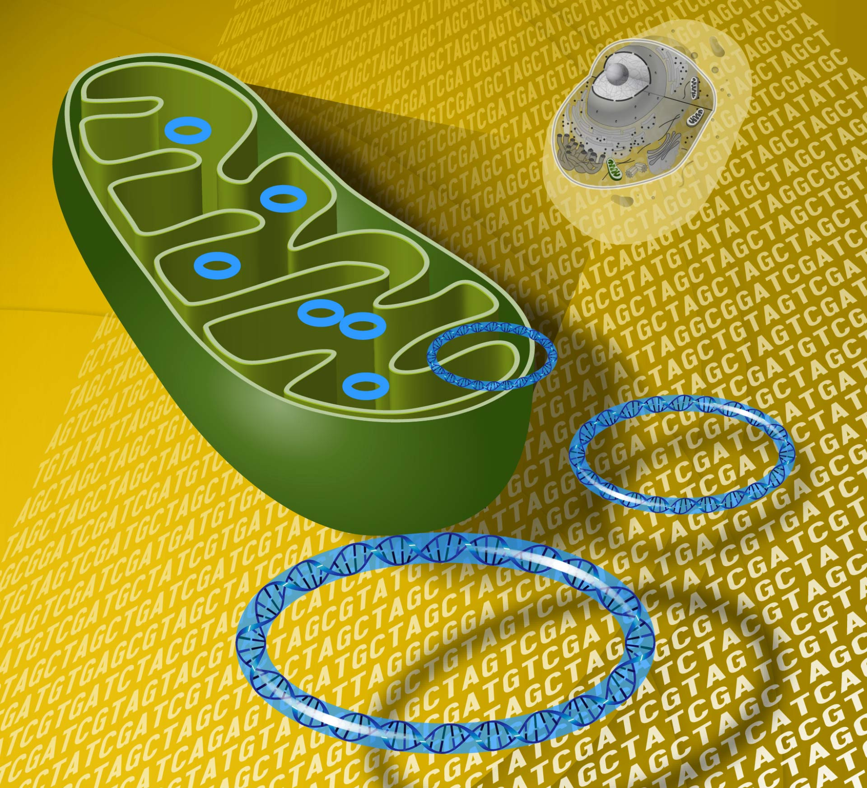
Mitochondrial DNA contains just 37 of the 20,000 to 25,000 protein-coding genes in our body. Unlike nuclear DNA, which comes from both parents, mitochondrial DNA comes only from the mother.

Slide 15
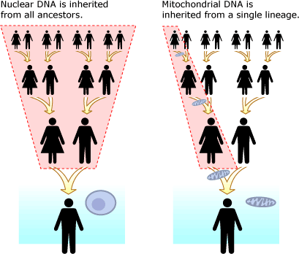

Slide 16
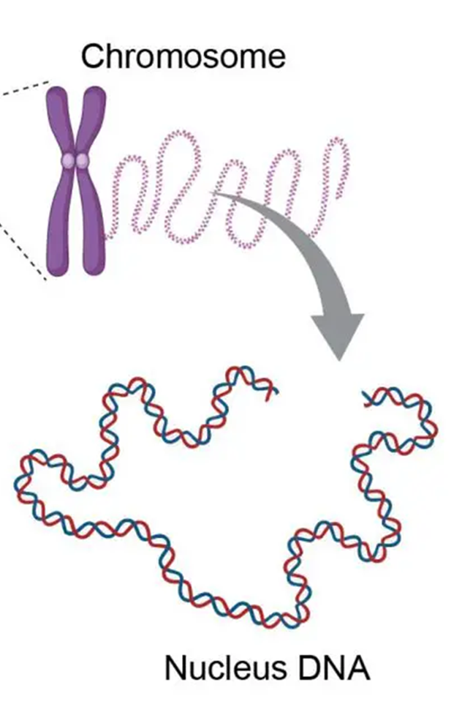
Nuclear DNA
Nuclear DNA (nDNA) is composed of several linear strands, which codes for almost all the proteins required by the cell.
Proteins (histones) bind and help to coil strands into chromosomes before replication and division.

Slide 17
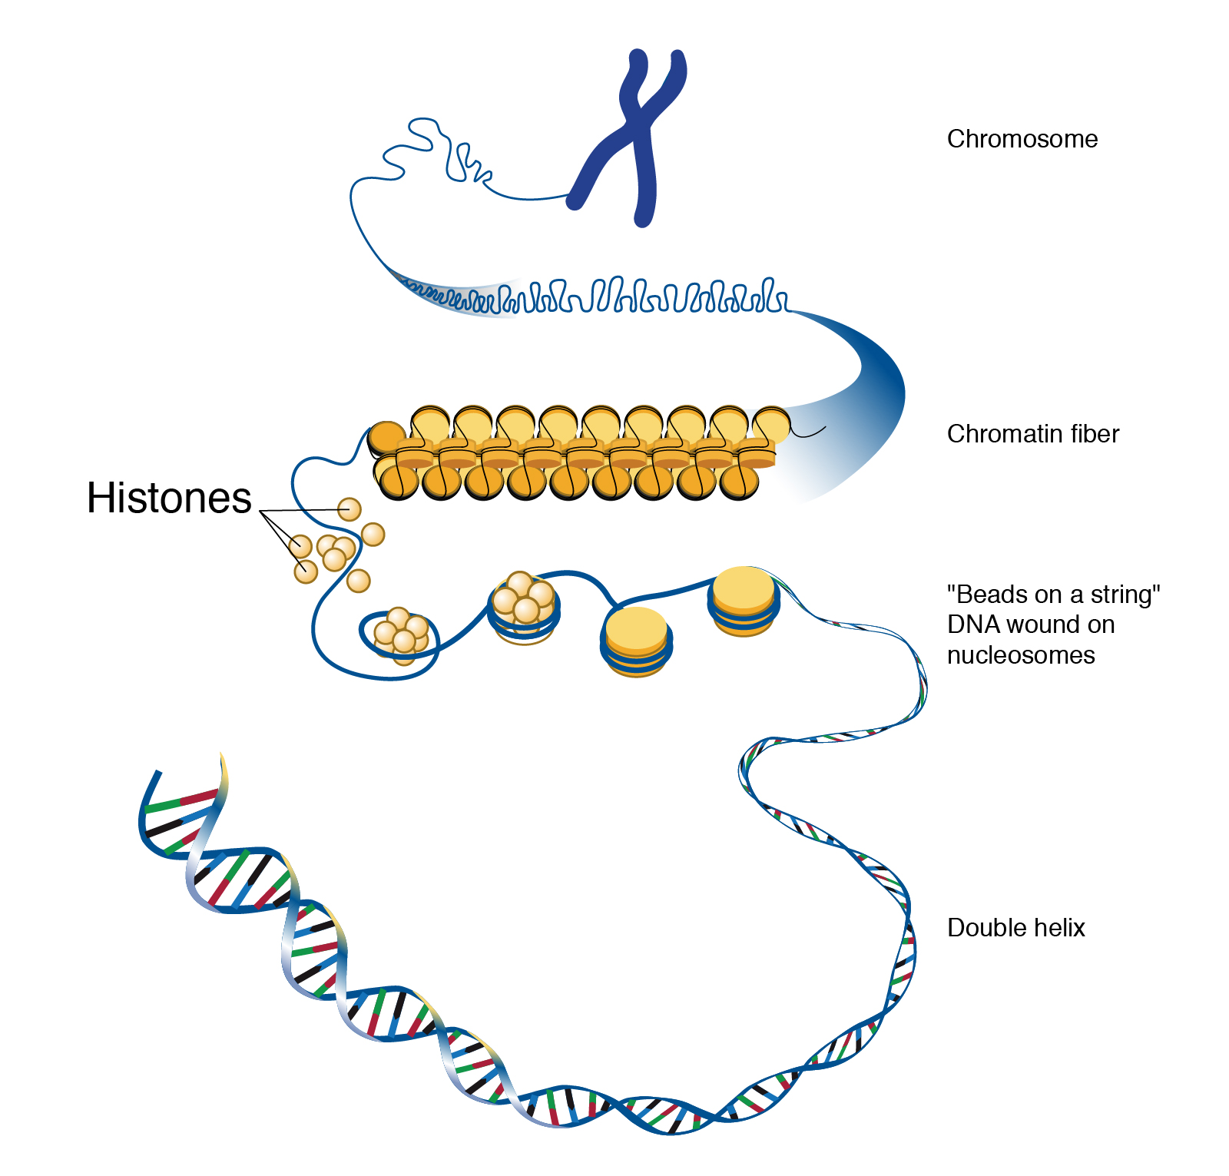

Slide 18
Compare and contrast
nucleotides
double stranded
protein bound
unbound
linear
circular
long
short
inherited from both parents
“maternal line”
code for proteins
code for just mitochondrial proteins
code for whole cell/organism
mtDNA nDNA

Slide 19
Success criteria
Label a diagram of a nucleotide.
Describe the 5’ and 3’ strands of DNA
List the four nitrogenous bases found in DNA
Compare and contrast nuclear and mitochondrial DNA

